Slide 1
Machine Learning
Gradient Descent
Tomas Karpati MD tc.datascience@gmail.com
054-2002430

Slide 2
Linear Regression
Linear Regression
Statistical solution:
Least Square Method
SSE = 𝞢( y - yhat )²
b = y - mx
m =
m
𝞢 (x_{i} - x) (y_{i} - y)
b
𝞢 (x_{i} - x)²

Slide 3
Differential Calculus
y = mx + b
DIfferential Calculus: derivative
y = f(x)
y’ = f’(x)
∆y
∆x
m =
𝒹 y
𝒹 x
m’=
b
Constant rate of change
Dynamic rate of change

Slide 4
Differential Calculus - Derivatives
Derivatives rules:
Constant rule:
y = k
𝒹
𝒹 x
(k) = 0
Power rule:
y = x^{n}
𝒹
𝒹 x
(x^{n})= nx^{n-1} = f’(x)
𝒹
𝒹 x
Constant multiple rule:
y = A f(x)
A f(x) =
A f’(x)
Sum rule:
y = x^{n} + x^{m}
𝒹
𝒹 x
𝒹
𝒹 x
𝒹
𝒹 x
(x^{n} + x^{m}) = (
(x^{n}))+( (x^{m}))

Slide 5
Differential Calculus - Derivatives
Derivatives rules:
Chain rule:
y = f(x) f(x) = g(x) y = f(g(x))
y = x²
𝒹 y
𝒹 g(x)
𝒹 y
𝒹 f(x)
𝒹 f(x)
𝒹 g(x)
𝒹 y
𝒹 z
= 2x . 2z
=
x = z²

Slide 6
Differential Calculus - Derivatives
Partial derivatives:
For a function of two variables, we calculate the partial derivative for one variable by treating the other variable as a constant
𝒹
𝒹 x
= f’(x) + f(y)
𝒹
𝒹 y
= f(y) + f’(y)
f(x,y) = f(x) + f(y)
f(x,y) = x³ + y⁵
𝒹
𝒹 x
= 3x² + 0
𝒹
𝒹 y
= 0 + 5y⁴

Slide 7
Gradient Descent
Linear Regression
y = wx + b
Sum of Squared Errors
SSE = 𝞢( y - yhat )²
Error
Cost (loss) function

Slide 8
Gradient Descent
Global minima
(convergence)
Error
Learning rate
Weight

Slide 9
Gradient Descent
Cost (loss) function
Mean Square Error
J_{m,b} = 𝞢( error )²
J_{m,b} = 𝞢( error )²
𝒹
𝒹 m
𝒹
𝒹 m
𝒹
𝒹 b
𝒹
𝒹 b
= 2.error.
error
= 2.error.
error
𝒹
𝒹 m
= 2error.
𝒹
𝒹 m
((mx+b) - y)
𝒹
𝒹 b
= 2error.
𝒹
𝒹 b
((mx+b) - y)
𝒹
𝒹 m
= 2error . x
𝒹
𝒹 b
= 2error . 1
𝒹
𝒹 m
= error . x
𝒹
𝒹 b
= error

Slide 10
Gradient Descent
Stochastic gradient descent (SGD)
Applies the gradient descent row by row
Batch gradient descent
Applies the gradient descent on all the rows at the time (matrix operation)

Slide 11
Gradient Descent
R
function GradientDescent(x1,y1) {
learn_rate <- 0.5
iter <- 1000
m <- 1
b <- 1
for (i in 1:iter) {
x <- x1[i]
y <- y1[i]
y_hat <- x*m + b
error <- y_hat - y
m <- m + (error * x * learn_rate)
b <- b + (error * learn_rate)
}
}
Python
def GradientDescent(x1,y1):
learn_rate = 0.5
iter = 1000
m = 1
b = 1
for (i in range(1,iter)):
x = x1[i]
y = y1[i]
Y_hat = x*m + b
error = y_hat - y
m = m + (error * x * learn_rate)
b = b + (error * learn_rate)

Slide 12
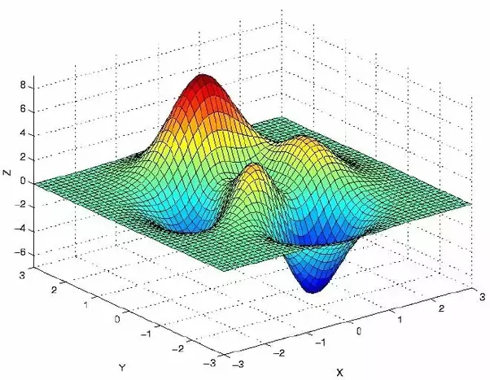
Gradient Descent
Local minima
Global minima

Slide 13
Gradient Descent
Linear Model
Cost Function
Gradient Desc
ŷ = w^{T}x
ŷ = wx + b
ŷ = wx + w₀
Loss = 𝞢((y - ŷ)²)
grad = 𝞢((y - ŷ)*x)
ŷ = w₁x₁+ w₂x₂ + ... + w_{n}x_{n} + b
ŷ1
ŷ2
ŷ3
...
ŷn
1 x11 x12 … x1m
1 x21 x22 … x2m
1 x31 x32 … x3m
... … … … …
1 xn1 xn2 … xnm
w0
w1
w2
...
wm
x11 x12 … x1m
x21 x22 … x2m
x31 x32 … x3m
… … … …
xn1 xn2 … xnm
w0 w1 w2 … wm
n x m
n x (m+1)
(m+1) x 1
1 x (m+1)
Notes:
m

Slide 14
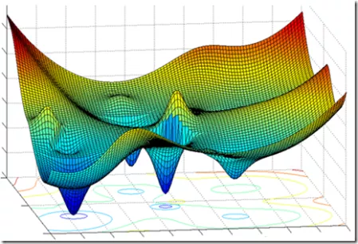
Gradient Descent

Slide 15
Least Squares Vs Gradient Descent
 | Least Squares Method | Gradient Descent Algorithm
Usage | Statistics | Machine Learning
Cost (loss) function | Squared errors | Any
Goal | Optimize betas | Minimize error
Type of method | Analytic / Non-iterative | Iterative
Final Results | Always the same | Depending on parameters

